Slide 1
Chapter – 12 system test planning and execution

Slide 2
Outline of the Chapter
Structure of a System Test Plan
Test Execution Strategy
A Multi-Cycle System Test Strategy
Characterization of Test Cycles
Prioritization of Test Cases
Test Effort Estimation
Function Points
Computation of Function Point
Test Case Creation Effort
Test Case Execution Effort
System Test Automation

Slide 3
Structure of a System Test Plan
The purpose of a system test plan is as follows:
It provides guidance for the executive management to support the test project
It establishes the foundation of the system testing part of the overall software project
It provides assurance of test coverage by creating a requirement traceability matrix
It outlines an orderly schedule of events and test milestones that are tracked
It specifies the personnel, financial, equipment, and facility resources required to support the system testing part of a software project

Slide 4
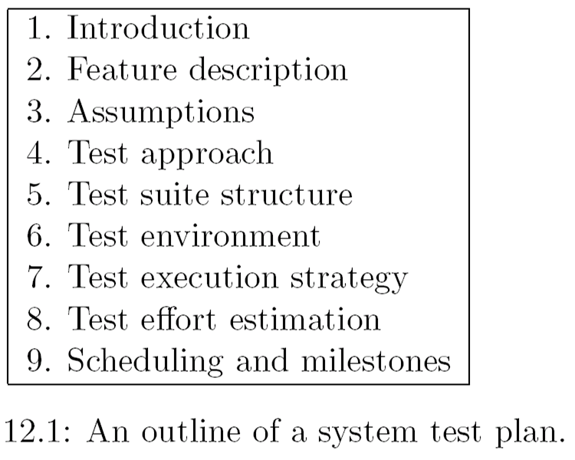
Structure of a System Test Plan

Slide 5
Introduction and Feature Description
The introduction section of the system test plan includes:
Test project name
Revision history
Terminology and definitions
Name of the approvers and the date of approval
References
Summary of the rest of the test plan
The feature description section summarizes the high level description of the functionalities of the system

Slide 6
Test Approach
The test approach section describes the following aspect of the testing project
Issues discovered by customers that were not caught during system testing in the past project are discussed and the preventive action that are being taken in this test project
If there are any outstanding issues that need to be tested differently need to be discussed here
A test automation strategy for writing scripts is a topic of discussion
Identify test cases from the database that can be re-used in this test plan
Give an outline of the tools, formats, and organizing scheme, such as traceability matrix that will be used and followed during the test project

Slide 7
Test Suite Structure
Detail test groups and subgroups are outlined based on the test categories identified in the test approach section
Test objectives are created for each test group and subgroups based on the system requirements and functional specification documents
Identification of test objectives provides a clue to the total number of test cases needs to be developed
A traceability matrix is generated to make an association between requirements and test objectives to provide the test coverage

Slide 8
Test Environment
Multiple test environments are constructed in practice
To run scalability tests one need more resources than to run functionality tests
To reduce the length of testing time
A schematic diagram of one or more test beds are presented in this section of the system test plan
A high-level graphic layout of the test architectures
A table of types of equipments, their quantities, and their descriptions to support the test architecture

Slide 9
Test Execution Strategy
The processes of system test execution, defect detection, and fixing defects are intricately intertwined
The key characteristics of those processes are as follows.
Some test cases cannot be executed unless certain defects are detected and fixed
A programmer may introduce new defects while fixing one defect, which may not be successful
The development team releases a new build for system testing by working on a subset of the reported defects, rather than all the defects
It is a waste of resources to run the entire test set T on a build if too many test cases fail

Slide 10
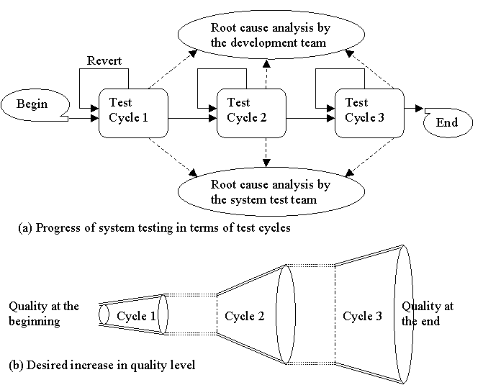
A Multi-Cycle System Test Strategy
The objective of the first test cycle is to detect most of the defects by executing all the test cases.
The objective of the second test cycle is to verify the fixes for the defects found in the first test cycle.
The objective of the third and final test cycle is to ensure that the software is stable before it can be released to the customer.
Figure 12.1: The concept of a cycle-based test execution strategy

Slide 11
Characterization of Test Cycles
Each test cycle is characterized by a set of six parameters:
Goals
Assumptions
Test execution
Revert and Extension criteria
Actions
Exit criteria

Slide 12
Characterization of Test Cycles
Goals
System test team sets its own goals to be achieved in each test cycle
These goals are ideal in the sense these are very high standard
Goals are specified in terms of the number of test cases to pass in a cycle
Assumptions
How often the builds will be selected during in a system test cycle?
For example “the team can accept builds from SIT group on a daily basis during a test cycle”
Test Execution
Prioritization of test execution changes between test cycles
Test cases that exercise basic functionalities have higher priority than the rest in the first test cycle
Test cases that have failed in one test cycle have a higher priority in the following test cycle
Test cases in certain groups have higher priority than others

Slide 13
Characterization of Test Cycles
Revert and Extension criteria
It may not be useful to continue a test cycle if it is found that a software is of poor quality
Often a test cycle is extended due to various reasons
A need to re-execute all the test cases in a particular test group because a large fraction of the test cases within the group failed
A significantly large number of new test cases were added while test execution was in progress
The conditions for prematurely terminating a test cycle and for extending a test cycle must be precisely stated

Slide 14
Characterization of Test Cycles
Actions
Too many test cases may fail during a test cycle
The development team is alerted
The developers take action in the form of root cause analysis (RCA)
Corrective actions are taken by updating the design specification, reviewing the code, and adding new test cases to the unit and integration test plan
The system test team has to design a large number of new test cases during a test cycle
The system test team initiates a root cause analysis (RCA)
The team studies the new test cases and categories them into different groups based on the functional requirements
The relevant requirements are studied to understand why the test team was unable to identify the objectives of these new test cases in the first place

Slide 15
Characterization of Test Cycles
Exit Criteria
An exit criterion specifies the termination of a test cycle
One may exit a test cycle even if goals for that particular test cycle are not fully achieved
The exit criteria are defined based on few quality metrics associated with the test cycle
These quality metrics must be monitored during the test cycle
Example of exit criteria
95% of test cases passed and all the known defects are in CLOSED state

Slide 16
Prioritization of Test Cases
Prioritization of test cases means ordering the execution of test cases according to certain test objectives
Formulating test objectives for prioritization of individual test cases is an extremely difficult task
In system testing, test cases are prioritized in terms of groups with common properties
In a multi-cycle based test execution strategy, test cases are prioritized in a group in each test cycles for three reasons:
initially the quality level of the system under test is not very high
the quality of the system keeps improving from test cycle to test cycle
a variety of defects are detected as testing progresses

Slide 17
Test Effort Estimation
The system test group needs to estimate testing effort to produce a schedule of test execution. Intuitively, testing effort defines the amount of work that needs to be done.
Two major components:
The number of test cases created by one person in one day
The number of test case executed by one person in one day

Slide 18
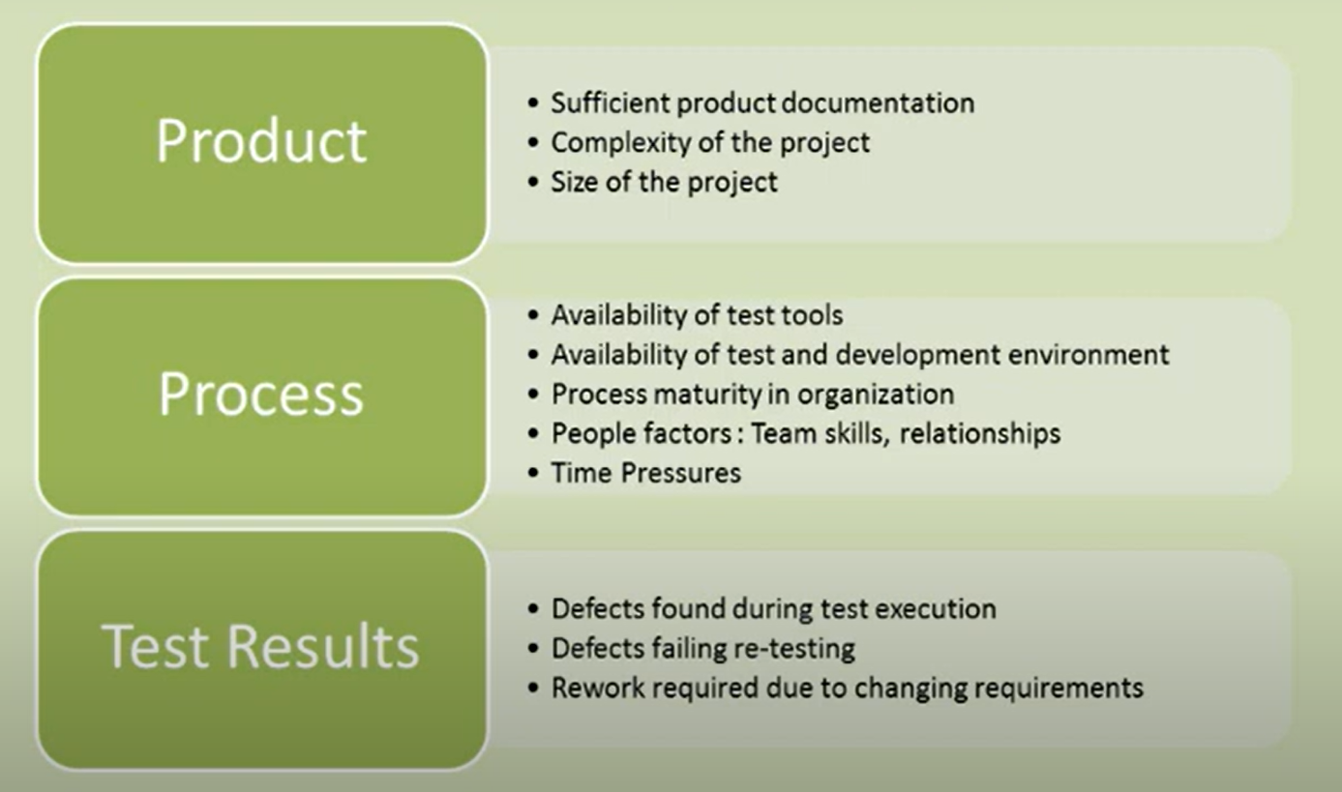
Factors affecting test effort

Slide 19
Test Effort Estimation
Estimation of Number of test cases
Estimation of Number of Test Cases Based on Test Group Category
It is straightforward to estimate the number of test cases after the test suite structure and the test objectives are created
Simply count the number of test objectives
Estimation of Number of Test Cases Based on Function Points
Total number of test cases = (Function Points)^{1.2}

Slide 20
Function Points
The central idea in the function point method is as follows:
Given a functional view of a system, in the form of the number of user inputs, the number of user outputs, the number of user on-line queries, the number of logical files, and the number of external interfaces, one can estimate the project size in number of lines of code required to implement the system and the number of test cases required to test the system
The function point of a system is a weighted sum of the numbers of
inputs,
outputs,
master files
inquiries produced to, or generated by, the software

Slide 21
Computation of Function Point
Step 1: Identify the following five types of components, also known as “user function types,” in a software system
Number of external input types (NI)
Number of external output types (NO)
Number of external inquiry types (NQ)
Number of logical internal file types (NF)
Number of external interface file types (NE)

Slide 22
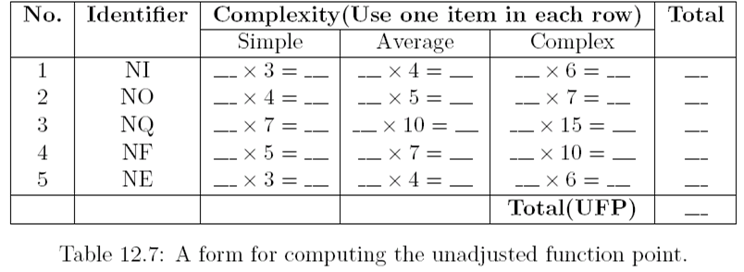
Computation of Function Point
Step 2: Analyze the complexity of each of the above five types of user function and classify those to three levels of complexities, namely simple, average, or complex
Compute the unadjusted function point (UFP) by using the form shown in Table 12.7
UFP = WFNI × NI + WFNO × NO + WFNQ × NQ + WFNL × NL + WFNE × NE

Slide 23
Computation of Function Point
Step 3: Identify 14 factors that affect the required development effort for a project. A grade – between 0 and 5 – is assigned to each of the 14 factors for a certain project.
The sum of these 14 grades is known as processing complexity adjustment (PCA) factor. The 14 factors have been listed in Table 12.8
In Table 12.8, the degree of influence of a factor on development effort is measured as follows:
Not present, or no influence if present = 0
Insignificant influence = 1
Moderate influence = 2
Average influence = 3
Significant influence = 4
Strong influence = 5

Slide 24
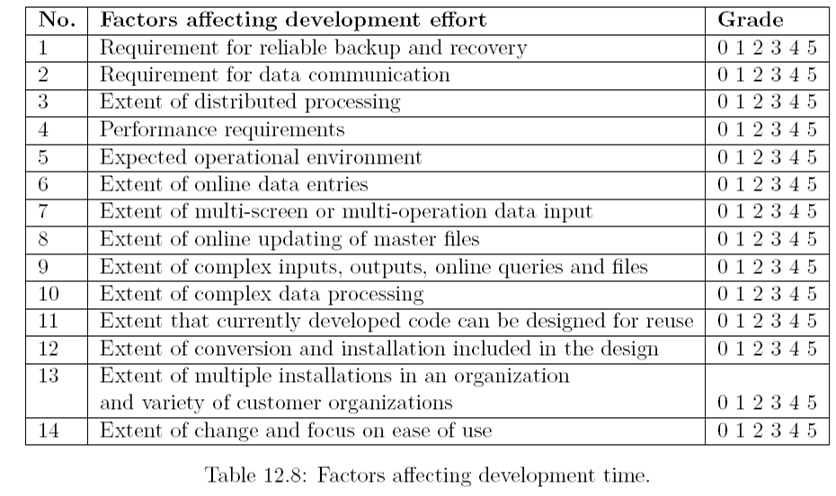
Computation of Function Point

Slide 25
Computation of Function Point
Step 4: Compute the function points (FP) of a system using the following empirical expression:
FP = UFP × (0.65 + 0.01 × PCA)
By multiplying the unadjusted function point, denoted by UFP, by the expression (0.65 + 0.01 × PCA), we get an opportunity to adjust the function point by +/- 35 percent.
Let us analyze the two extreme values of PCA, namely 0 and 70 (= 14 × 5).
PCA = 0 : FP = 0.65 × UFP
PCA = 70 : FP = UFP × (0.65 + 0.01 × 70) = 1.35 × UFP
The value of FP can range from 0.65 × UFP to 1.35 × UFP
The value of FP is adjusted within a range of +/- 35 percent by using intermediate values of PCA.

Slide 26
Exercise 1
Consider the following system:
User wants to maintain customer data and product data and needs to reference supplier data.
User wants to add, change and delete customer data, wants to inquire on Customer and also requires four different reports on Customer with calculated data.
User wants to add, change, delete Product data, wants to inquire on Product and also requires a report on Product with calculated data.
User wants to inquire on Supplier using supplier number and also requires a report on Supplier with totaling results.
All of these data are of average complexity and overall system is moderately complex i.e. assume processing complexity adjustment factor is 46.

Slide 27
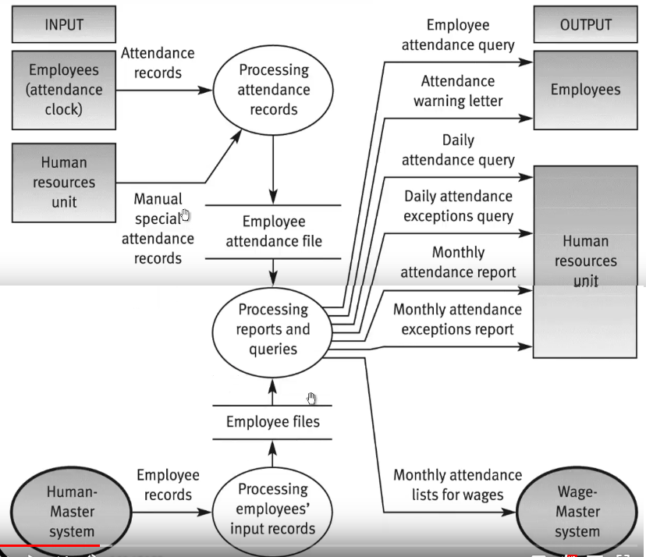
Exercise 2 Employee tracking system

Slide 28
Exercise 3
A retail store has developed a new application, Frequent Buyer Program (FBF), to track customer purchases. The customer fills out a paper application and gives it to the store clerk. The clerk then adds the customer’s information online. The clerk can also list customers, view a customer’s detailed information and change a customer’s info. A report is produced daily listed customers that were added with their addresses.

Slide 29
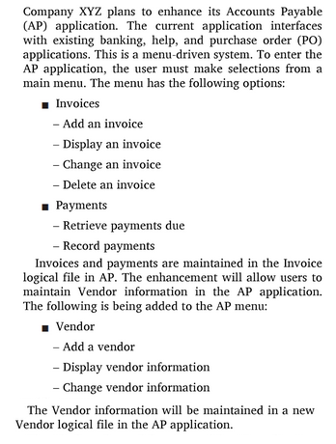
EXERCISE 4

Slide 30
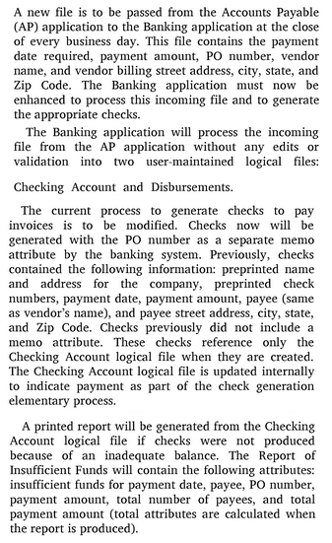
Exercise 5

Slide 31
EXERCISE 6
An Application A is created where there are two transaction types: Add Employee (by entering Employee ID, Employee Name and Employee Hire Date) and Update Employee (Employee ID cannot be updated whereas other two fields can be updated). The Employee Job Assignment attribute on the input record is validated against the Job Assignment logical file maintained in Application C; this is the only attribute accessed in the Job Assignment logical file by Application A; however, the Job Assignment logical file has 51 attributes within Application C. If the validation passes, the Employee logical file is updated in Application A; a total of 12 fields are maintained and/or referenced in the Employee logical file within Application A. If the validation fails, no update is made and an error report is produced. Also, the same Application A, contains a screen related to customer management. Use the screen in below Figure as a reference. Note that the “Add Customer” button causes the Customer data maintained inside the application boundary to be updated with all the fields entered by the user (assume all fields are to be entered mandatorily, consider two fields of zip code as single one). The “Clear Screen” button causes all of the fields to be erased. The “Error Message Window” displays any errors associated with validations performed against an externally maintained Zip Code Data file after the “Add Customer” button is pressed. All the data is stored in the Customer file.

Slide 32
System Test Automation
Benefits of system test automation
Test engineer productivity
Coverage of regression testing
Re-usability of test cases
Consistency in testing
Test interval reduction
Reduces software maintenance cost
Increased test effectiveness

Slide 33
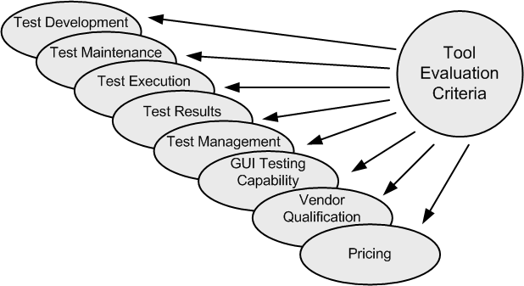
Evaluation and Selection of Test Tools
Figure 12.3: Broad criteria of test automation tool evaluation

Slide 34
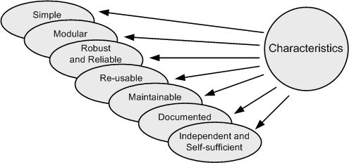
Characteristics of Automation Test Cases
Figure 12.5: Characteristics of automated test cases

Slide 35
Early automation
Advantages of early automation:
(a) More time is available to evolve, fine-tune, and improve the automated test cases.
(b) Testers learn the automated tool(s) and test environments via hands-on experience.
(c) Early automation provides earlier feedback to the developers about the defects.
Disadvantages of early automation:
(a) The development project needs the discipline of a visual freeze and stable functional specification.
(b) Early automation can delay the first release ofthe system, because of unanticipated problems with automation and diversion of test resources from manual testing.

Slide 36
lATE automation
Advantages of late automation:
(a) The system under test is more stable.
(b) There is less maintenance, i.e., throw-away and re-work of the automated test cases are minimal.
(c) Testers have more time to learn the automation tools and processes before automating.
(d) Manual testing provides direction for development of test cases.
Disadvantages of late automation:
(a) Automation which is delayed may never be done because of pressure of other duties.
(b) Testers do not benefit from an early intensive hands-on learning experience.
(c) There is little or no regression testing of the early system release, because manual regression testing under deadline pressure is very difficult.

Slide 37
Thank You!!

